Slide 1
Foundations of American Government
How did the colonist get the idea for the Declaration of Independence and the constitution?
K. Stafford MBMS 2012

Slide 2
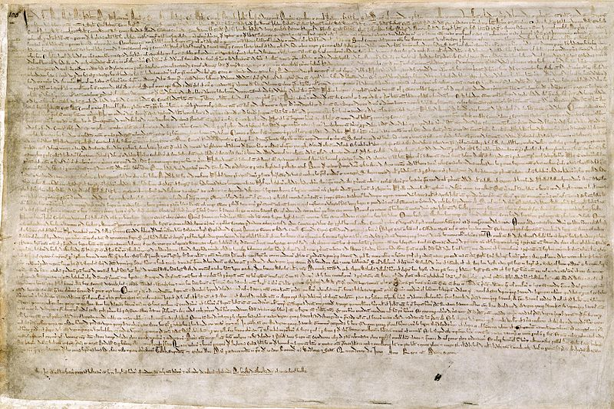
Magna Carta

Slide 3
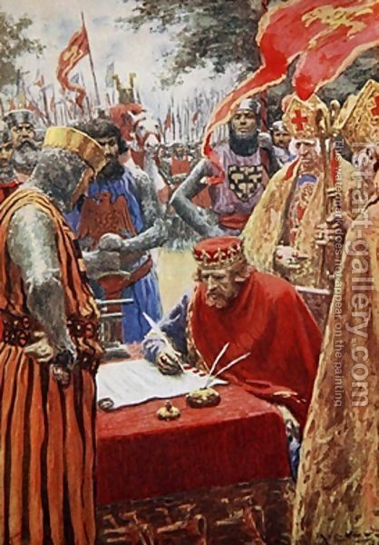
Magna Carta
Who: Signed by King John after a rebellion by the nobles
When:1215 C.E
Where: Signed at Runnymede in the English countryside

Slide 4
Magna Carta
What:
Latin for ‘Great Charter’
Limited the Kings Influence
Couldn’t place certain taxes on nobles without their permission
Granted Rights to free men- equal treatment under law and a trial by one’s peers
Granted Nobles(Lords/Aristocracy) the right to rebel if the king broke his agreement
Limited Government- the principle that a ruler or a government is not all-powerful

Slide 5
Magna Carta
Why:
Laid down the precedent (done before) of limiting the government.
Survived throughout the Middle Ages and through Modern Day
Was used as a guide in first writing the charters and establishing the colonies overseas.
Colonist believed that the Magna Carta and the English Bill of Rights protected them as English Citizens

Slide 6
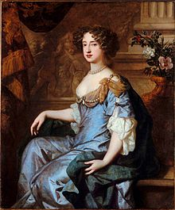
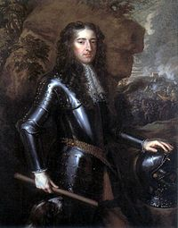
The Glorious Revolution
Parliament- In England it is the highest legislature, consisting of the sovereign(King/Queen),
the House of Lords, and the House of Commons.
1688 Parliament forced King James II from the throne , asked his daughter Mary and her husband William rule instead
Had to agree to some terms first
Queen Mary II
King William III

Slide 7
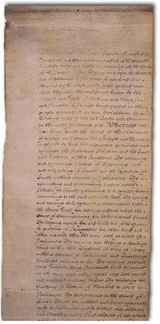
English Bill of Rights
Who : Rights set down by Parliament and agreed to by William and Mary before they could accept the English Crown.
When: 1689
Where: Passed as an act of law in London, England
What: Protected the rights of the English Citizen.

Slide 8
English Bill of Rights
Why: Was heavily influenced by John Locke
Was used as a model by James Madison when drafting the first ten amendments to the US Constitution (US Bill of Rights)
There are numerous similarities between the two documents including…
The right to petition
Right to bear arms
Freedom of Speech

Slide 9
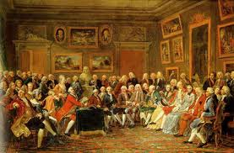
Enlightenment
A period of history where the old ways and tradition were replaced with the ‘Age of Reason’ and Science
During this time Newton Discovered his 3 laws of Motion
The ideas of citizenship and the role of the government are evolving
French Salon- a gathering of people with the aim to educate and please…
they really enjoyed talking about politics!

Slide 10
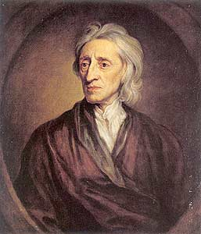
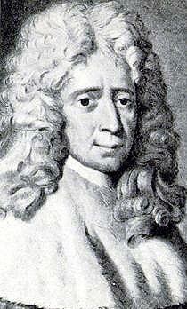
Thinkers of the Enlightenment
John Locke
Baron de Montesquieu

Slide 11
Mayflower Compact
Who: signed by the men of the Mayflower
When: November 11, 1620 C.E.
Where: Provincetown Harbor, MA ( Plymouth Rock)
What: a social contract between the members on the Mayflower

Slide 12
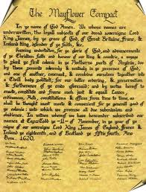
Mayflower Compact
Why
Established a direct democracy decades before the colonies revolted from England
Was a Social Contract (Enlightenment Idea!)
Established the idea that the colonist must ‘govern themselves’ in order to survive

Slide 13
Common Sense
Who: Written by Thomas Paine
When: January 10th 1776
Where: Published in Philidelphia
What: A pamphlet arguing for the colonies to rebel against the king and England

Slide 14
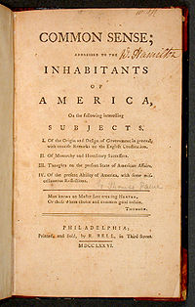
Why
The book was written in simple language…allowed for all levels of education to participate in the discussion of the future of the Colonies
Sold 120,000 copies in the first 3 months
Not only denounced( rejected) the King and England but provided an argument for the establishment of and Independent American County

Slide 15
Paine’s Top 7 Reasons Against the Brits
It was absurd for an island to rule a continent.
America was not a "British nation"; but was composed of influences and peoples from all of Europe.
Even if Britain were the “mother country" of America, that made her actions all the more horrendous, for no mother would harm her children so brutally.

Slide 16
Paine’s Top 7 Reasons Against the Brits
4. Being a part of Britain would drag America into unnecessary European wars, and keep her from the international commerce at which America excelled.
5. The distance between the two nations made governing the colonies from England unwieldy. If some wrong were to be petitioned to Parliament it would take a year before the colonies received a response.
6. The New World was discovered shortly before the Reformation . The Puritans believed that God wanted to give them a safe haven from the persecution of British rule.
7. Britain ruled the colonies for her own benefit, and did not consider the best interests of the colonists in governing them.

