Slide 1
Influencing the Government
Merritt Brown Middle School 2012
K. Stafford

Slide 2
Public Opinion
Refers to the ideas and attitudes that people hold about an issue or a person
Two roles in a democracy
Public opinion helps to shape the decisions that officials make
Public opinion directly affects how successful a president is in carrying out their agenda
Public Opinion will vary depending on age, political beliefs, gender, religion, education ect.

Slide 3
Forming Public Opinion
Personal background- gender, age, race, religion, job,
Mass Media shapes public opinion since that is the way most people receive their information
Interest Groups- Work to convince the public and elected officials to support their position

Slide 4
Characteristics of Public Opinion
Three main factors- Direction, Intensity, Stability
Direction- Is the Public Opinion Positive or Negative
Intensity- How strong is the opinion held. Normally depends on how close to home the issue hits.
Stability- How likely are they to change their views
3 min Pause. Oil drilling.

Slide 5
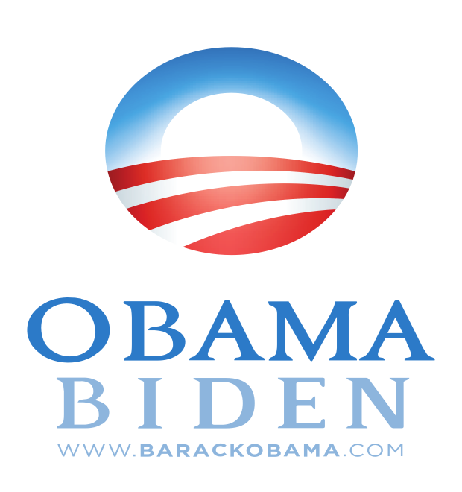
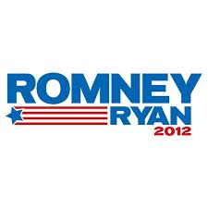
Elections and Public Opinion
Election results give an mixed reflection of the Public Opinion
People vote for a candidate for many reasons
Party affiliation
Support most of their platform
Liked the way they looked

Slide 6
Polls
Public Opinion Poll- is a survey in which individuals are asked to answer questions about a particular issue or person
Pollsters are often employed by politicians to see how the public feels about issues
Select a random group includes all races, genders, ages
Carefully worded questions
Push Polls use questions designed to get a certain type of answer, highly criticized

Slide 7
Polls
Pros | Cons
Tell Politicians how the public feels | Argue that Politicians focus on pleasing public instead of doing the right thing
Shows support or disapproval for politicians | Can discourage voting
Polls can target certain groups so there is a clear answer to how people feel on the issues | People get over whelmed with polls during election season

Slide 8
Influencing the Media
Two types of Mass Media… Print and Electronic
Most Media outlets are private businesses so they publish what will attract the most readers/viewers
When the media focuses on a certain issue the public often becomes worried about it this affects the public agenda
Public Agenda- those issues that receive the most time money and effort from the government

Slide 9
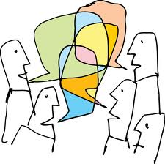
Public Agenda Issues
National Finances
Lowering National Debt and Borrowing
Funding Other programs
Education
Differs from state to state
How to fund new programs and initiatives
Military Spending
Increase/Decrease Spending
Deploying or Bringing Home troops
Environment
Preserving the Environment
Utilizing Natural Resources
Social Issues
Welfare
Social Security
Three min Pause

Slide 10
The Media and Politics
Very complex relationships… Reporters need stories and Politicians need media coverage to get their message out
Officials try to use the media to their advantage
Leak- to secretly pass on information
May leak information in order to get a gauge on how the public feels about the issue

Slide 11
The Media and Politics
Mass Media can act as a ‘Watchdog’
Watchdog- the role played by a media organization that exposes illegal practices or waste
Media and National Security sometimes clash. Government needs Media to get news out but sometimes there is news that could threaten national security

Slide 12
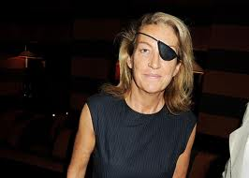
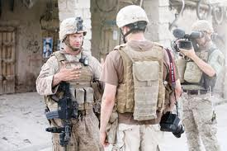
War Reporters
War Reporters the report from the front lines face the same dangers as the soldiers
Marie Colvin Died in Feb of 2012 in Syria. She lost her eye in 2001 due to shrapnel from a bomb in Sri Lanka

Slide 13
Protecting the Press
Because of the 1st Amendment the US government does not have Prior Restraint with the media
Prior Restraint- government censorship before material is published

Slide 14
Freedom Within Limits
The Media is liable if they publish information that they know is false or untrue and deliberately harmful this is known as libel
Most State have shield laws that protect a reporters sources

Slide 15
Regulating the Media
Despite having Freedom of Press the government does have some regulation… there are only so many channels for radio and TV
To receive a license must meet certain standards
The Federal Communications Commission oversees broadcasters. It cannot censor broadcast but there are rules and consequences if these rules are broken.

Slide 16
Interest Group Column Notes
Fold paper hamburger style two times. You should get four columns on your paper when you unfold
Label column one Types of Interest Groups, Column Two Influencing the Government, Column Three Techniques of Interest Groups and Column Four Regulating Interest Groups
Under Column One space out Economic, Public and Other
Under Column Two Space out Election Activities, Going to Court and Lobbying.

